Slide 1
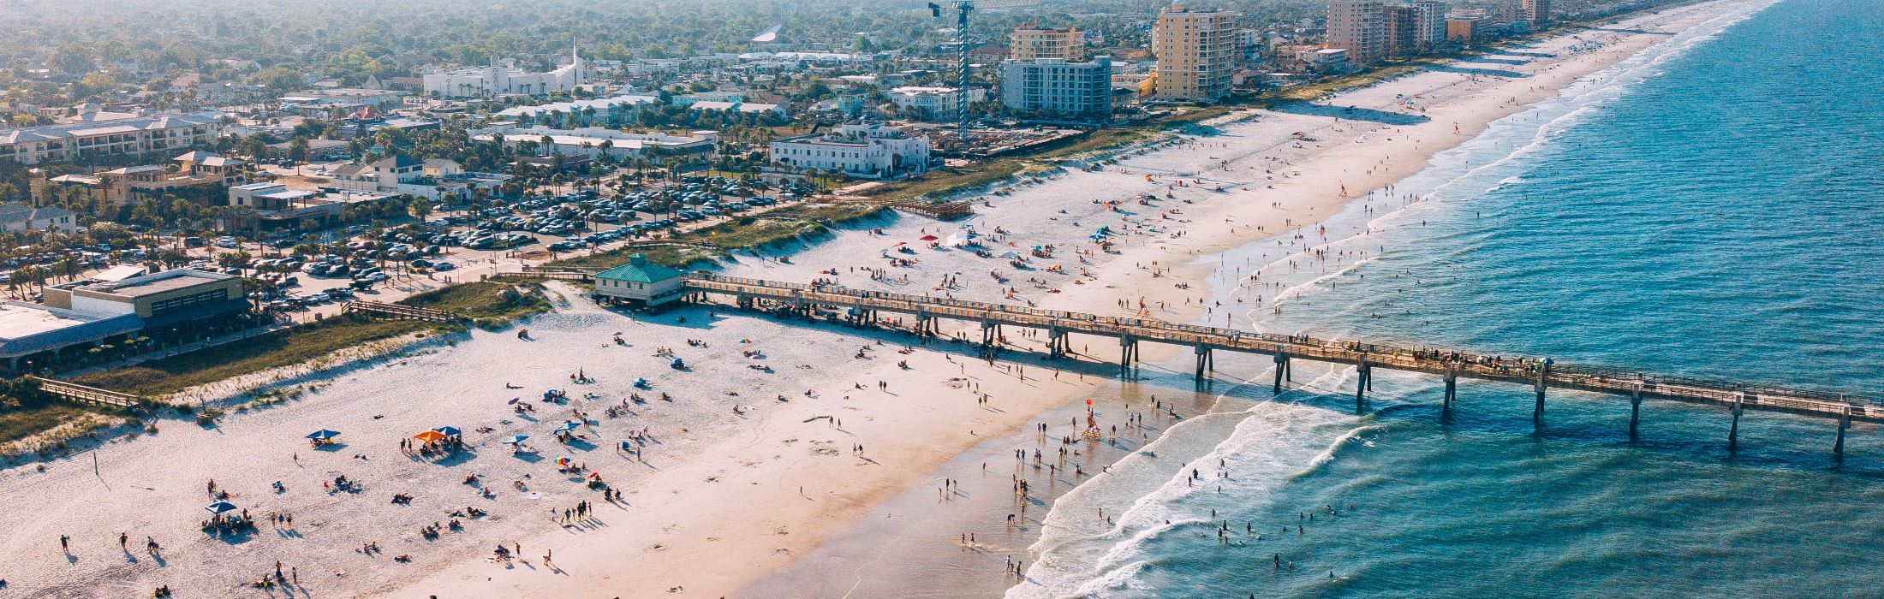

City Council Workshop
Land Development Code Update
Thursday, August 28th, 2024

Slide 2
Workshop Mission
As we engage in the public participation portion of this project, please remember to be respectful of everyone’s time. These workshops are designed to receive a broad range of public input and include multiple ways for your opinion to be heard. The purpose of these meetings is to gain insight on the general, overarching view of the City of Jacksonville Beach’s land development code, comprehensive plan, and vision for the future of the City. The changes we are discussing tonight are not immediate solutions, they are long-term resolutions that come to fruition over time through new development and redevelopment in the City of Jacksonville Beach.
It is important to understand that all updates to the land development code and comprehensive plan impact new development and redevelopment. Existing development will not be impacted by these changes.
For additional information, meeting agendas, submitting a comment, and project resources please visit the project website at cojbupdate.com or submit a comment via email to cojbupdate@kimley-horn.com
Thank you for your attendance and participation in this exciting process,
City of Jacksonville Beach & Kimley-Horn and Associates.

Slide 3
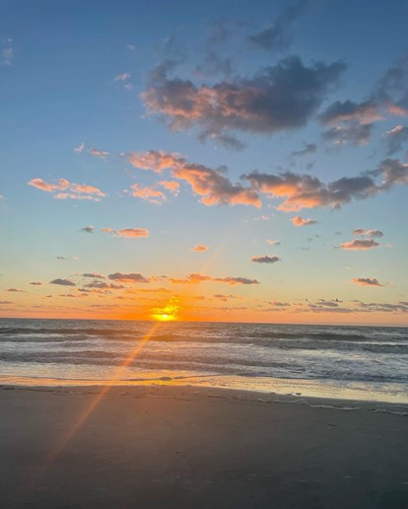
Quick Refresher
        City Vision Statement
        A vibrant coastal community that embraces “the beach life”
Comprehensive Plan:
Guiding document of a municipality, establishing the vision, intent, and strategies for its future long-range development as well as short-term redevelopment
Land Development Code (LDC):
        Implements the Vision, Intent, and Strategies of the City’s Comprehensive Plan which, in turn, affects the quality of life through policies, projects, and programs.

Slide 4
Bert J. Harris Disclaimer
Private Property Rights Protection Act
“Inordinate burden” has come to be defined as action that “has directly restricted or limited the use of real property such that the property owner is permanently unable to obtain the reasonable, investment-backed expectation for the existing use of the real property or a vested right to a specific use of the real property with respect to the real property as a whole, or that the property owner is left with existing or vested uses that are unreasonable such that the property owner bears permanently a disproportionate share of a burden imposed for the good of the public, which in fairness should be born by the public at large.”

Slide 5
Project Timeline
CP Workshops (BOA, PC, & City Council)
Amend CP Recommendations
On-going Website Updates
CP Hearings
Create Final CP Updates
LDC Hearings (PC & City Council)
Create Final LDC Revisions
June –
December 2023
December 2023 – July 2024
October 2024 – November 2024
December 2024
August 2024
We are here.
Phase 2
Phase 3
LDC Workshops
Amend LDC Changes
Final CP Clean Copy
Final LDC Clean Copy
Develop Final CP Recommendations
Final CP Strikethrough / Redline Version
Develop Final LDC Recommendations
Final LDC Strikethrough / Redline
*Total of One (1) Workshop Remaining: City Council
BOA = Board of Adjustments PC = Planning Commission CRA = Community Redevelopment Authority

Slide 6
Proposed LDC Changes

Slide 7
Exhibits added within LDC
Lot Definitions
Yard Definition
Design Standards

Slide 8
Exhibits added within LDC cont.
Residential Fence
Nonconforming Structures

Slide 9
Exhibits added within LDC cont.
Intersection Visibility
Off-street Parking

Slide 10
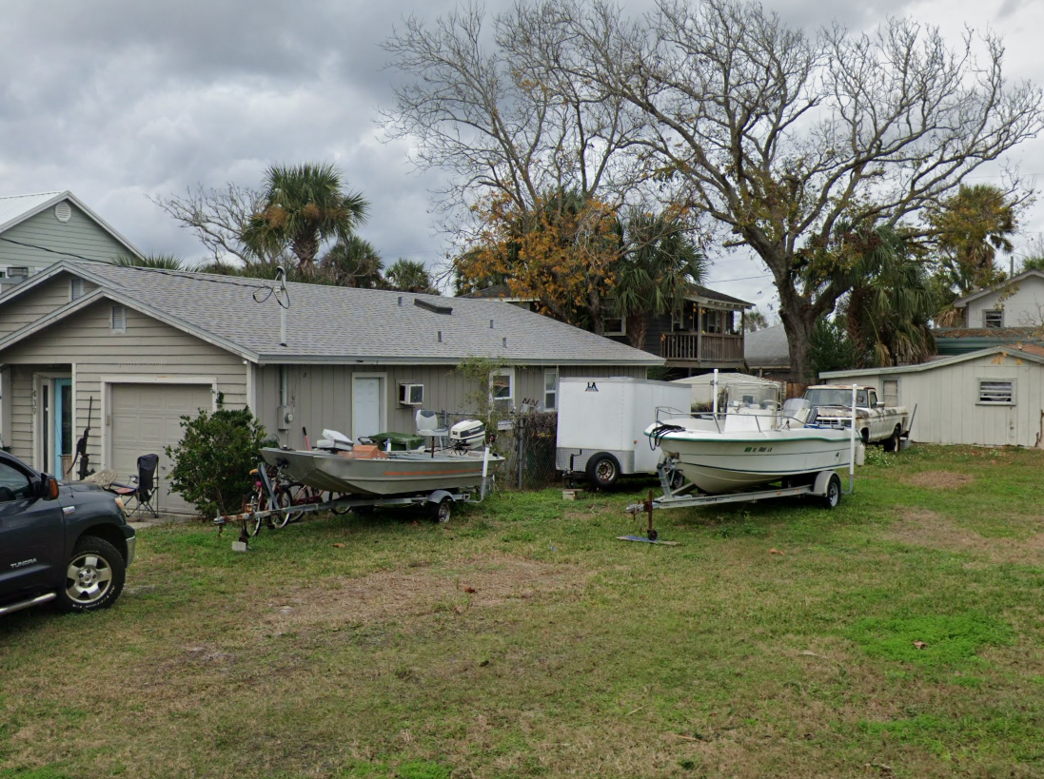
Parking
Parking Reductions
Reductions for multi-modal transportation, landscaping, other types of parking design, etc.
Flexibility
Flexibility for staff to make a determination on adequate parking for the proposed use and location.
Payment in Lieu of
Revised the payment in lieu of option to be more practical.
Boat Parking
Limiting the maximum number of parked boats to two (2) per residence.
CBD Parking
Reduced the Required Parking to Reflect ITE Urban Standards, 50% blanket reduction, exemption zone
Parking
Updated to reflect ITE Standards
Notes:
Need additional details on boat/rv parking regulations

Slide 11
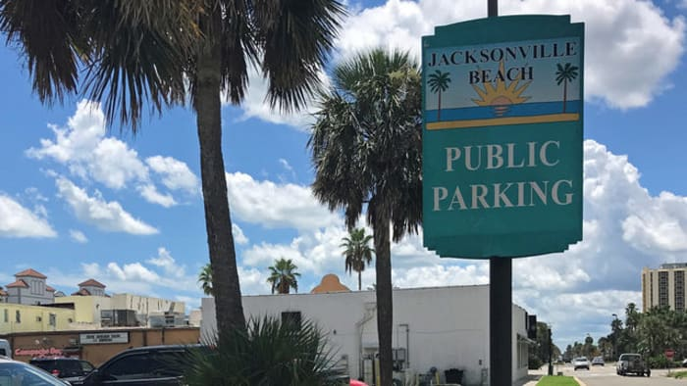
Parking Tables Updated and CBD Table Added

Slide 12
Parking Reductions (Commercial Uses Only)
Off-Street Parking Reductions
 | Central Business District (CBD) | All other zoning designations*
Bicycle Parking | Maximum off-street parking reduction of twenty (20) percent. One (1) percent reduction for every two (2) bicycle parking spaces. | Maximum off-street parking reduction of twenty (20) percent. One (1) percent reduction for every two (2) bicycle parking spaces.
Compact, EV, and/or Golf Cart Parking | Maximum off-street parking reduction of ten (10) percent. One (1) percent reduction for every (1) compact or golf cart parking space. | Maximum off-street parking reduction of five (5) percent. One (1) percent reduction for every (1) compact or golf cart parking space.
Motorcycle Parking | Maximum off-street parking reduction of five (5) percent. One (1) percent reduction for every (1) motorcycle parking space. | Maximum off-street parking reduction of five (5) percent. One (1) percent reduction for every (1) motorcycle parking space.
Pervious Parking Area | Maximum off street parking reduction of five (5) percent. One (1) percent reduction for every (1) standard vehicular pervious parking space. | Maximum off street parking reduction of five (5) percent. One (1) percent reduction for every (1) standard vehicular pervious parking space.
Proximity to Public Parking (<0.25 mile) | Off-street parking reduction of ten (10) percent. | Off-street parking reduction of five (5) percent.
Proximity to Urban Trail (<300 ft.) | Off-street parking reduction of ten (10) percent. | Off-street parking reduction of five (5) percent.
Enhanced Landscaping | Provide (1) shade tree and reduce (1) parking space | Provide (1) shade tree and reduce (1) parking space
MAXIMUM REDUCTION | Fifty (50) percent. | Thirty (30) percent.
*Excluding restaurant uses.
Notes:
Add pervious pavement

Slide 13
Examples of Bicycle Parking

Slide 14
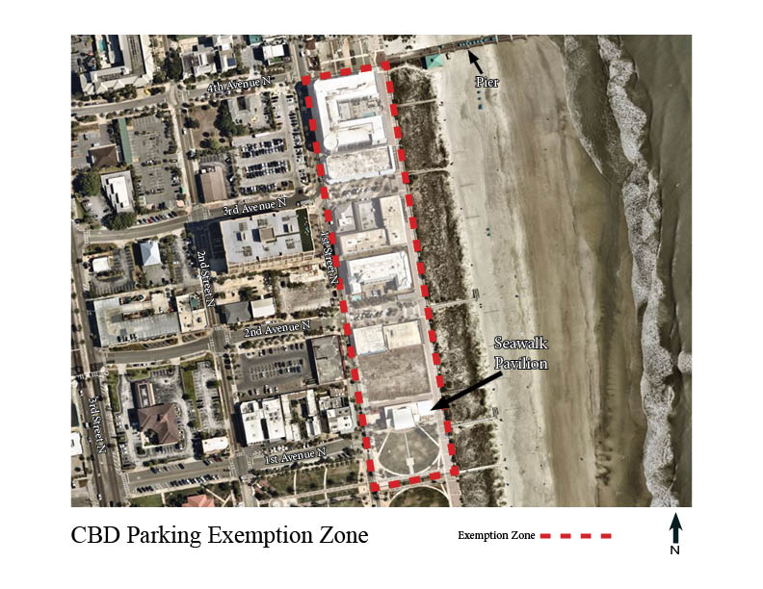
Parking Exemption Zone

Slide 15
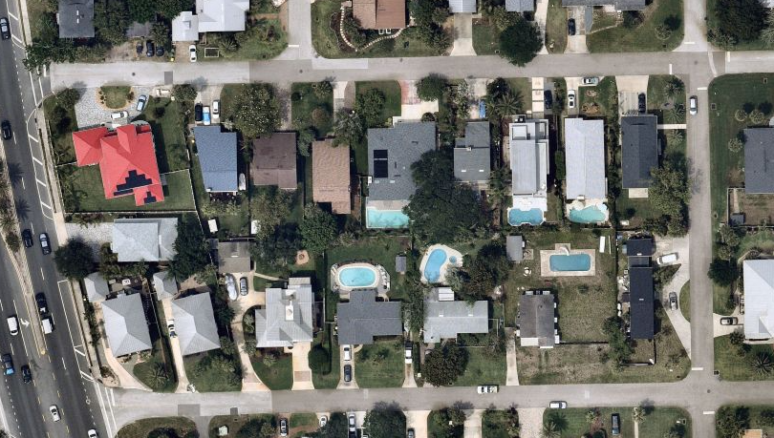
Residential Lot Coverage
 | Existing | Proposed
Lot Coverage | 35% | 35% (principle structure under roof)
Impervious Surface Ratio (ISR) | - | 50%
Notes:
Add existing lot coverage / maybe graphic to show

Slide 16
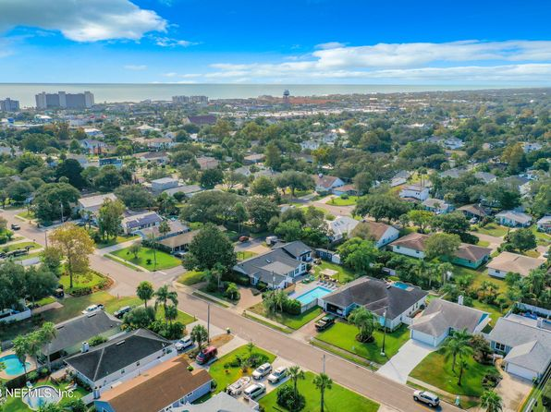
EXISTING-Residential Lot Standards
 | Total Lots | Median Area (Square Feet) | Existing Minimum Lot Area (Square Feet) | Existing Setbacks (Front/Side/Side/Rear)
RS-1 (Single-Family) | 3,233 | 9,113 sf | 10,000 sf | 25’/10’/10’/30’
RS-2 (Single-Family) | 2,412 | 6,250 sf | 7,500 sf | 20’/5’/10’/30’
RS-3 (Single-Family) | 549 | 4,971 sf | 6,000 sf | 20’/5’/10’/30’
 |  |  | 6,000 sf | 20’/10’/10’/30’
 |  |  | 4,000 sf | 20’/0’/15’/20’

Slide 17
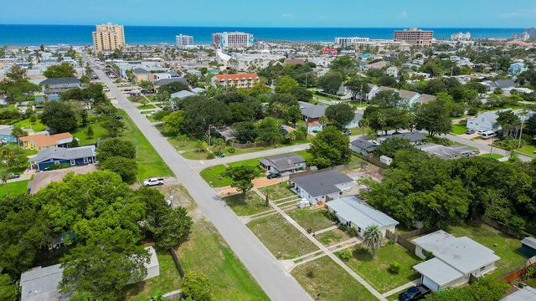
PROPOSED-Residential Lot Standards
 | Total Lots | Median Area (Square Feet) | Proposed Minimum Lot Area (Square Feet) | Proposed Setbacks (Front/Side/Side/Rear)
RS-1 (Single-Family) | 3,233 | 9,113 sf | 9,000 sf | 25’/10’/10’/20’
RS-2 (Single-Family) | 2,412 | 6,250 sf | 6,000 sf | 20’/5’/5’/20’
RS-3 (Single-Family) | 549 | 4,971 sf | 5,000 sf (single-family) | 20’/5’/5’/20’
 |  |  | 6,000 sf (Two Unit TH) | 20’/0’/10’/20’
 |  |  | 4,000 sf (zero lot line) | 20’/0’/15’/20’

Slide 18
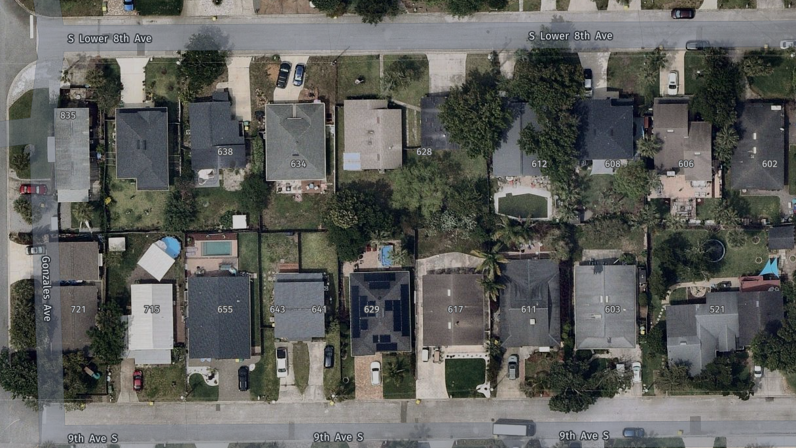
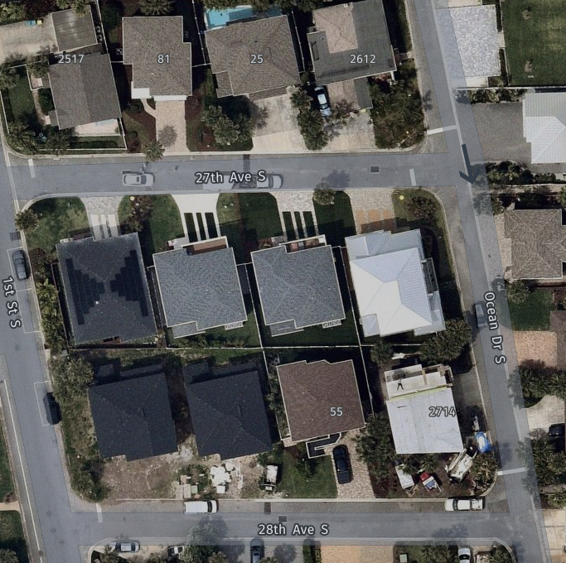
Prevailing Setbacks
Pending administrative approval, setbacks can be reduced to match the prevailing setbacks, therefore preserving the ocean view for properties.

Slide 19

Article III added to Article II
The Contents within ‘Article III. – Rules of Construction’ were revised and added as a subsection within ‘Article II. – Interpretation of the Land Development Code’

Slide 20
Article VI
Article VI. Development Review Procedures added Conditional Use Criteria and Standards

Slide 21
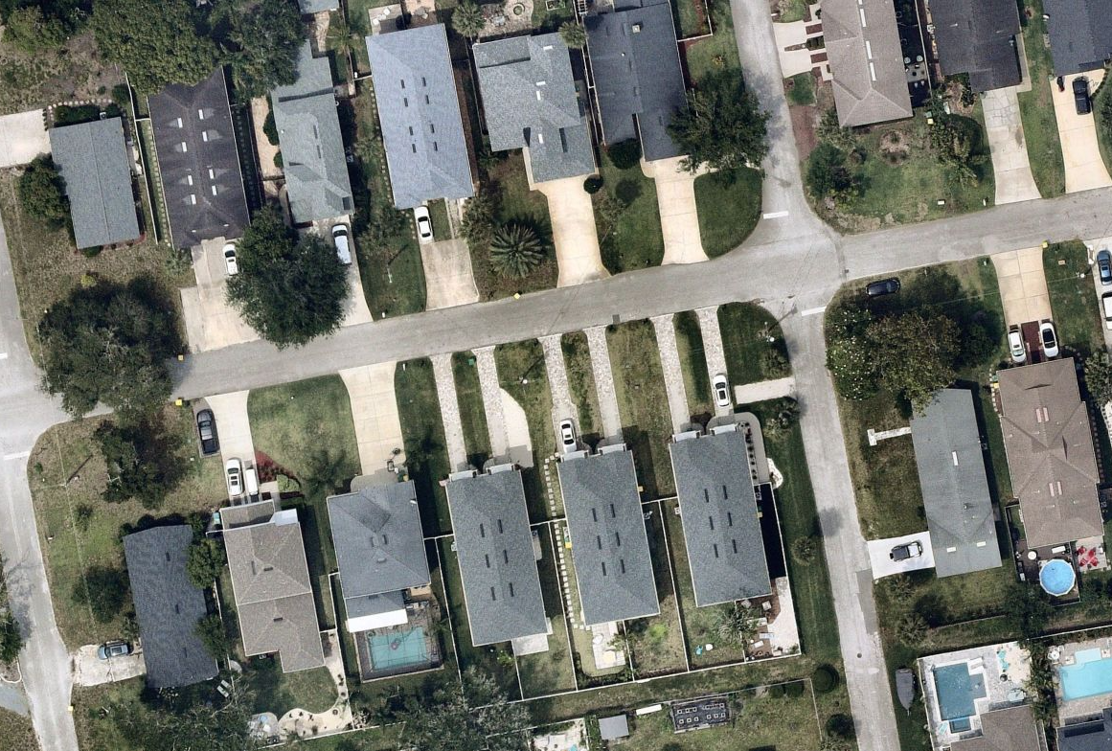
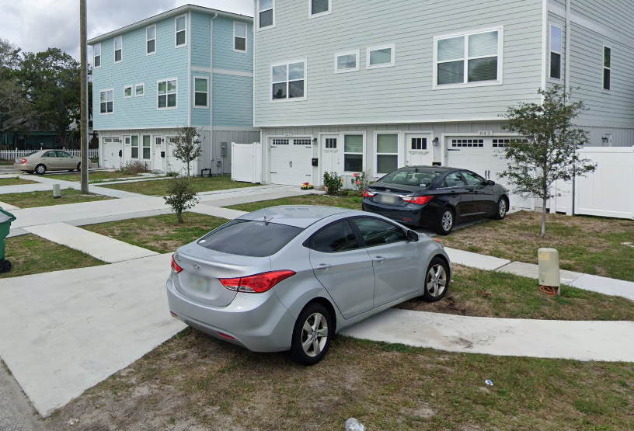
Townhomes
  Increasing the minimum width of townhomes west of 3rd St. from 15ft.
  to 24 ft.
    24’ will permit a two-car garage, and therefore a two-car driveway
  Townhome definition revised to permit townhomes to be attached by a breezeway or wall.

Slide 22
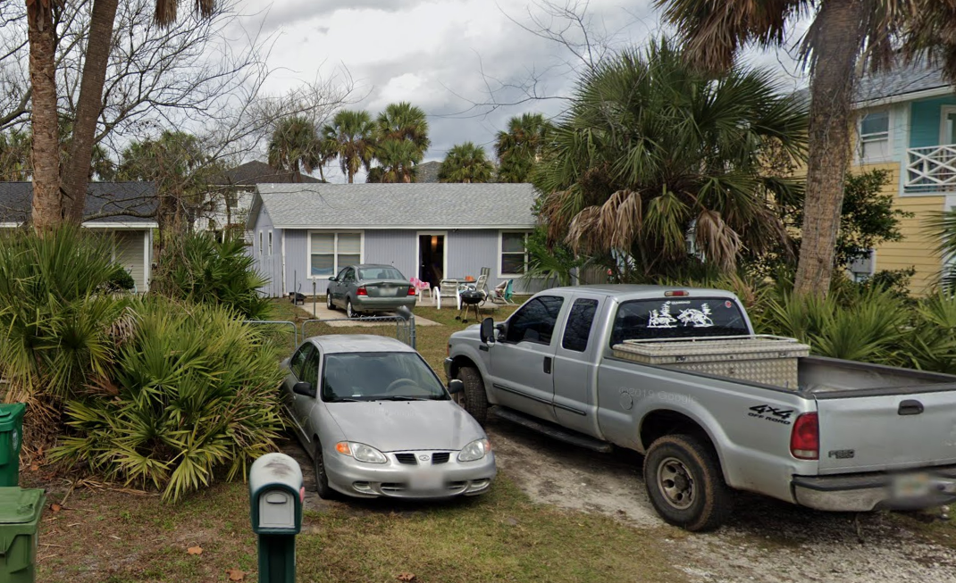
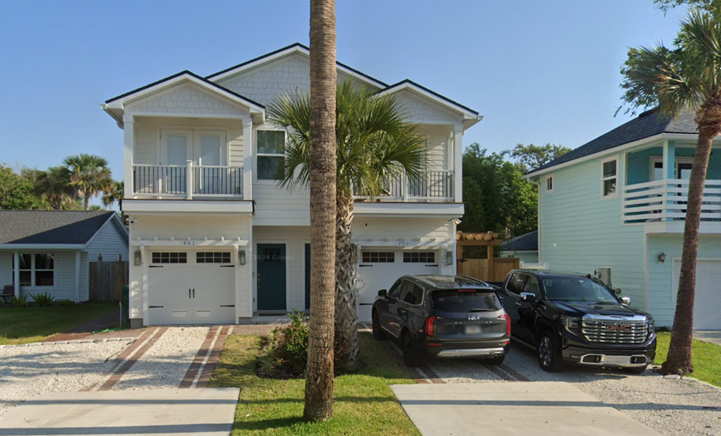
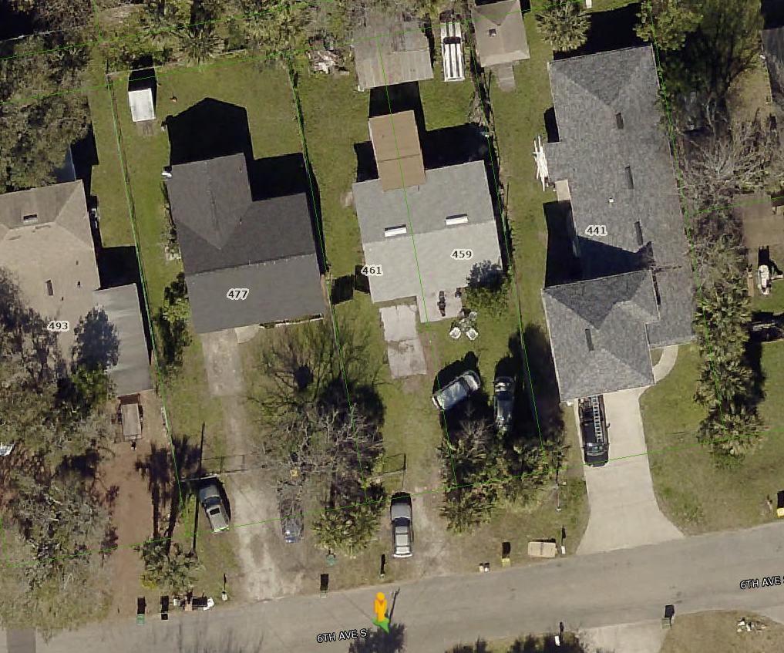
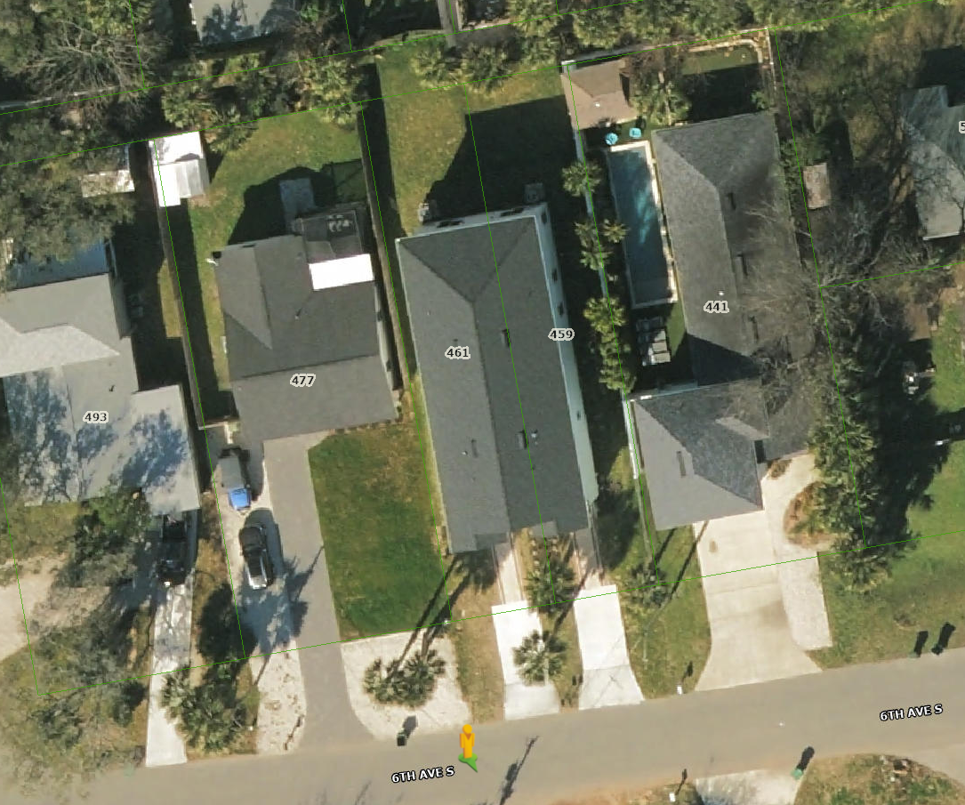
2019
2023
Notes:
Google (n.d.). [Google Maps location of 461 6th Avenue South Jacksonville Beach, FL]. Retrieved August 21, 2024, from https://www.google.com/maps/@30.2822805,-81.3925154,3a,88.4y,8.21h,63.14t/data=!3m7!1e1!3m5!1s36wIKYX-OKSXCFnDwUBOcA!2e0!5s20190101T000000!7i16384!8i8192?coh=205409&entry=ttu

Slide 23
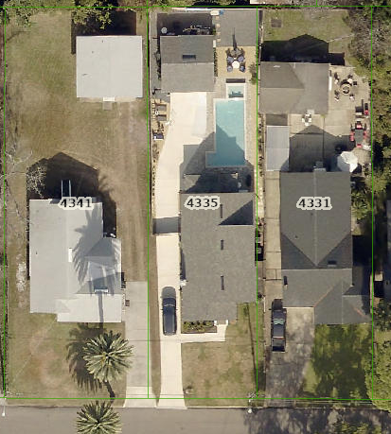
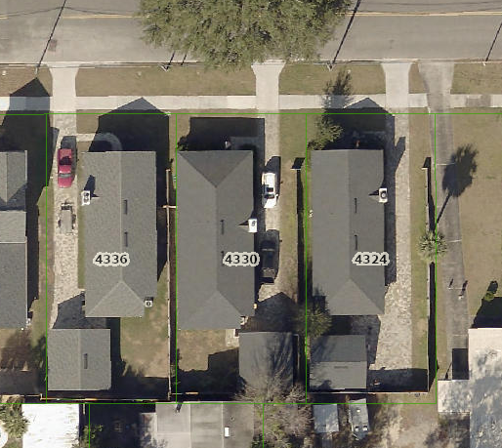
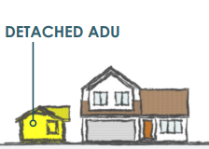

Slide 24
Accessory Dwelling Units (ADU)
Accessory dwelling units are only permissible by conditional use and if located within RM-1 and RM-2 zoning districts.
Parcel-The subject parcel shall only contain one (1) single-family dwelling unit at the time of application.
Minimum Lot Size: 5,000 square feet
Minimum Square Footage- the ADU size shall be limited to 350-500 square feet
Minimum Parking Required- one (1) space for the ADU and two (2) spaces for existing single-family dwelling unit (garage not enclosed)
Compatibility- The ADU must be compatible in design and materials as the primary structure
Height- shall not exceed fifteen (15) feet in height
Permanency-the structure shall be secured to the ground per Florida Building Code (as amended)
Ownership- The existing single-family residence must be owner occupied and file a notarized affidavit to that effect.
Utilities- There shall only be one (1) electrical meter and water meter for both the single-family residence and the ADU
Notes:
https://www.flhousing.org/wp-content/uploads/2019/08/ADU-Guidebook.pdf\
(5) The establishment of a new accessory dwelling unit shall only be allowed if the lot area of the principal building is at least 5,000 square feet
(7) The floor area of the accessory dwelling unit shall be no less than 300 square feet and no greater than 1,200 square feet. A variance to increase this amount may be requested provided that the total building coverage does not exceed district standards.

Slide 25
Revised Supplemental Standards
Clarifying Supplemental Standards
Accessory Uses
Accessory building shall not exceed 625 square feet in ground floor area.
Boats and RVs
Parking of heavy vehicles in RS-1, RS-2, RS-3, and RM-2 or residential uses in RD or PUD.
No more than 2 boats per residential lot.
Fences
Limited to up to two (2) feet above the allowed six (6) feet.
The additional height shall be composed of either lattice or slats to allow visibility above six (6) feet.
Balcony Encroachments may be allowed 2 ft into the required setback
Removed:
Junk and salvage yards (moved to Conditional Uses)
Service stations and gasoline sales (moved to Conditional Uses)
Travel trailer parks and campgrounds (moved to Conditional Uses)

Slide 26
Revised Conditional Use Standards
Accessory Dwelling Units.
Only permissible by conditional use if located within RM-1 and RM-2 zoning districts.
Camps and RV Parks
Commercial Use in Residential Zoning District.
Uses which are not residential in nature shall follow the standards to ensure compatibility within the surrounding area.
Hotels and Motels.
For hotels and motels within the CBD, the site design standards shall apply.
Service Stations and Gasoline Sales.
Shall apply to the location, design, construction, operation and maintenance of a new construction automotive service stations and other gas dispensing and sales facilities.
Travel Trailor Parks and
Campgrounds.
RV Boat and Storage.
Conditional uses are those uses which are generally not compatible with the other land uses permitted in a zoning district, but with individual review and control of their location, design, configuration and intensity and density of use, buildings and structures, and the imposition of conditions pertinent thereto in order to ensure the appropriateness of the use at a particular location, may be permitted in the zoning district as a conditional use.
Added as a Conditional Use. Moved from Supplemental Standards.
Added as a Conditional Use. Moved from Supplemental Standards.
All individual spaces shall abut an interior drive meeting minimum width requirements

Slide 27
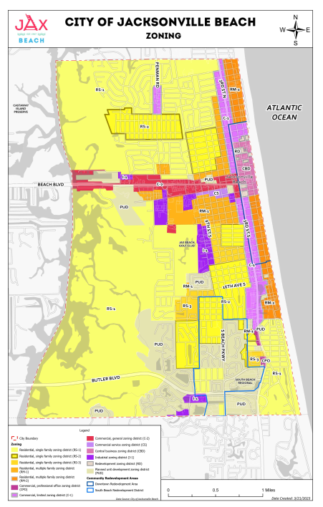
Zoning
Removed Daycares as permissible in Commercial Service (CS) zoning designation.
Making a user-friendly GIS Zoning Map.
Consider updating some zoning areas to the more appropriate zoning area that actually fits what is on the ground.

Slide 28
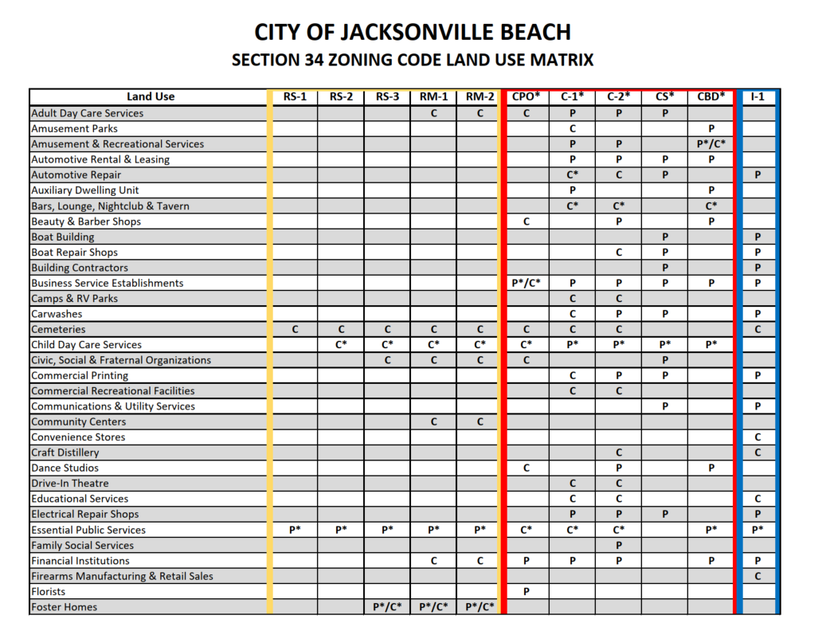
Zoning District
Matrix
Permitted Uses
Conditional Uses
Additional Restrictions

Slide 29
Preserve Neighborhood Character
Reducing lot sizes and setbacks to make existing structures conforming.
Charter Restricts the Height.
ADU’s
  Helps address workforce/affordability
  Preserves the character of neighborhoods by keeping the existing single-family homes in the MF Zoning District
  Added Strict Regulations (ISR, Lot Coverage, etc.)
  Would not increase density, they are already allowed these units
Regulated the number of boats in the front yards.
Townhome width increase to allow two cars in the driveway (west of 3rd St) to reduce on-street parking.
Allow more home improvements by establishing reasonable yard requirements.

Slide 30

Feedback Time!
  Contact Us:
  COJBcomments@kimley-horn.com

