Slide 1
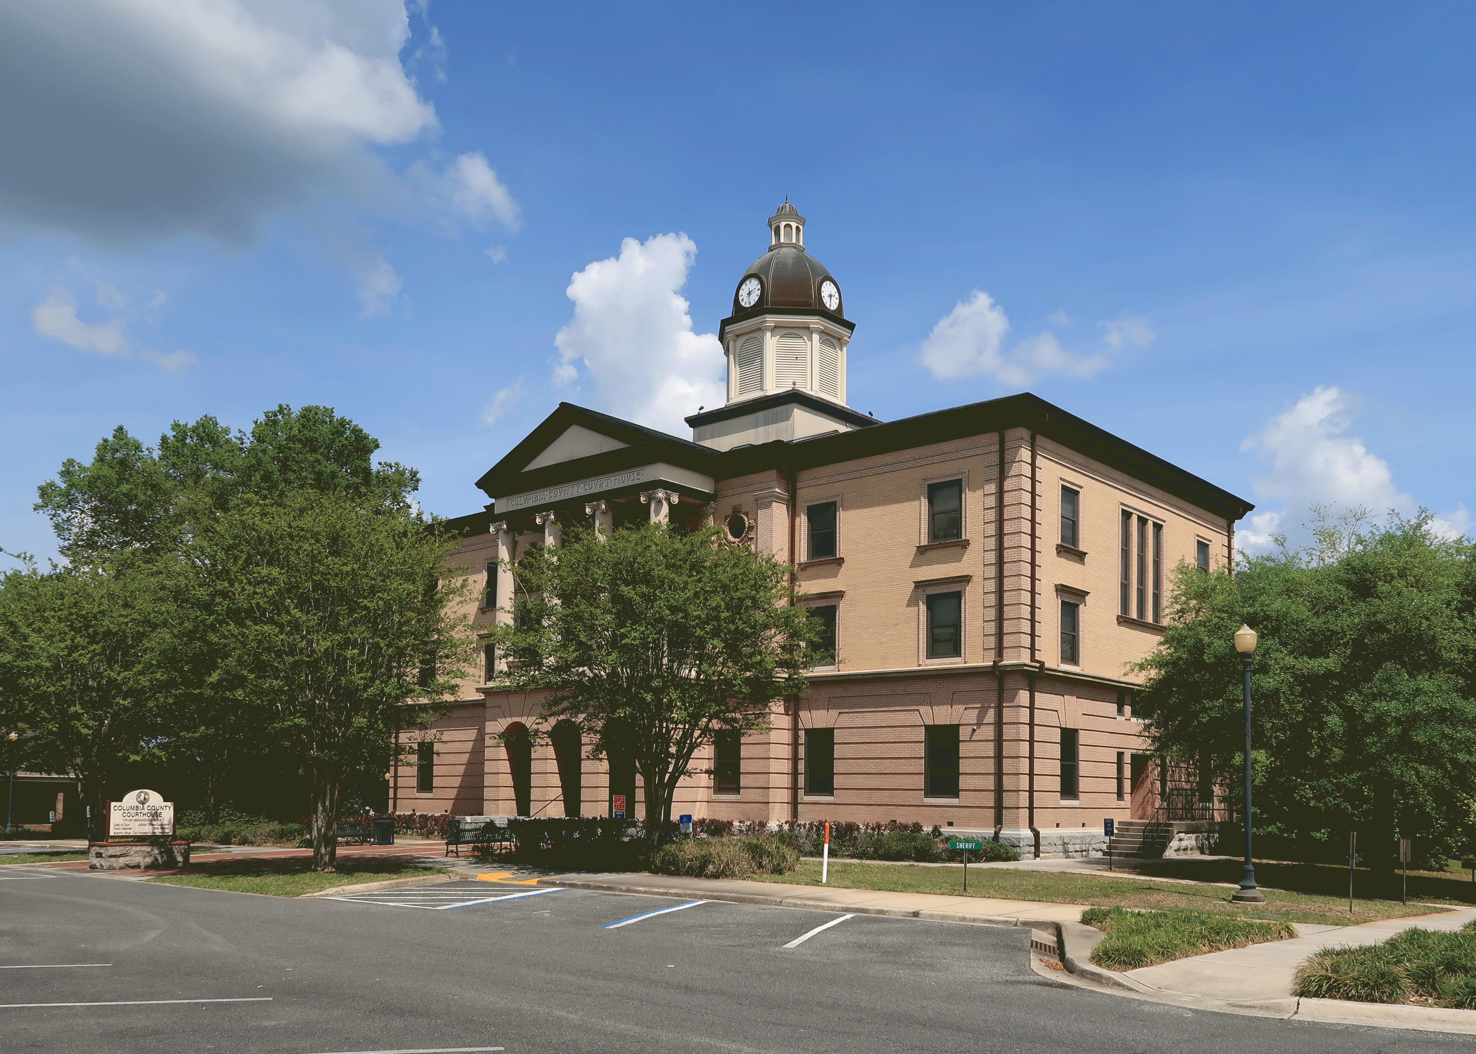
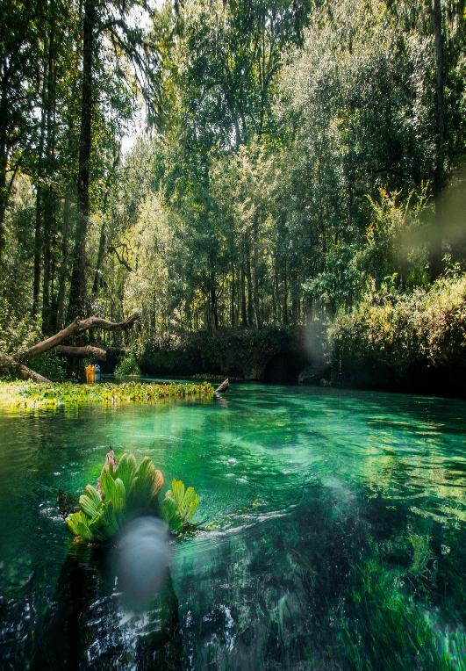



Columbia County
Comprehensive Plan and Land Development Regulations Update
Columbia County Kimley-Horn and Associates, Inc.

Slide 2

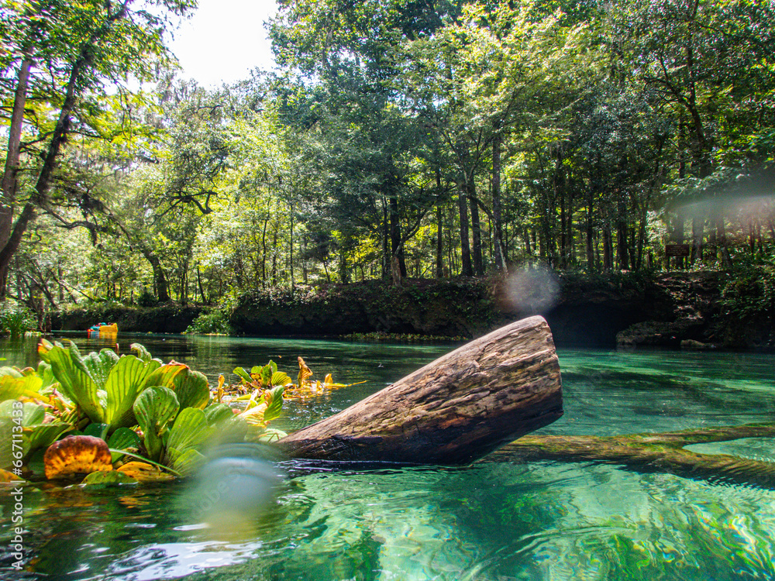

Workshop Agenda
Project Overview
Public Engagement Update
Permit Workflow
Preliminary Potential Changes
Senate Bill 180 Info
Open Discussion
Project Timeline

Slide 3
Comprehensive Plan
A set of high-level policies intended to serve as the Community’s Vision and to guide the development of a community, typically over a 10–20-year period.
Usually thought of as the “why” for land development
“The Columbia County Comprehensive Plan is Columbia County's key guide for growth management and provides the framework for how the County will continue to develop.”
Land Development Regulations (LDR)
Regulations that help implement the policies of the Comprehensive Plan
Usually thought of as the “how” for land development

Slide 4
Public Engagement Opportunities
Kimley-Horn and Columbia County staff have held several public engagement opportunities, such as:
Distributed flyers, QR code cards, and full-size boards throughout the county
Pop-up Pancakes with a Ranger
June 26th, 2025
Lake City & Columbia County 4th of July Celebration
July 4th, 2025
Business and Development Community Workshop (approx. 20 people)
July 25th, 2025
Open House for Citizens and Business Owners (approx. 6 people)
September 7th, 2025
Staff Workshop
September 24th, 2025
Board of County Commissioners Workshop
Today
Notes:
We also distributed flyers, QR code cards, and full size boards to locations throughout the county.

Slide 5
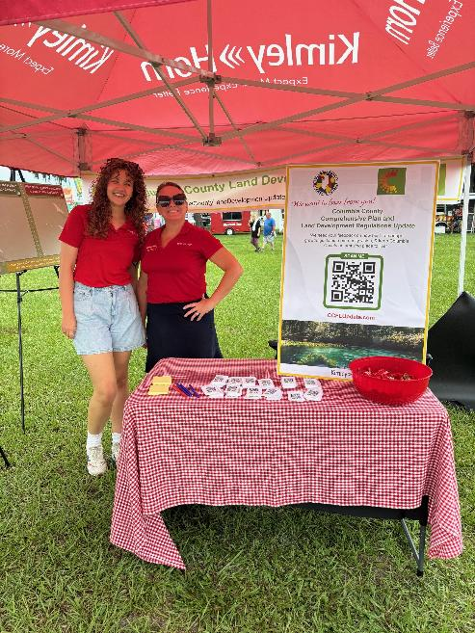
Online Survey Results
An online survey on the growth of Columbia County ran from June 18th to September 21st. Received 176 responses.
Typical questions include:
What excites/concerns you about the growth of the County
Regulation and Visual preference questions regarding signs, fences, and trees
Where you want growth and general comments
Notes:
Need to talk about the types of questions we asked and why.

Slide 6
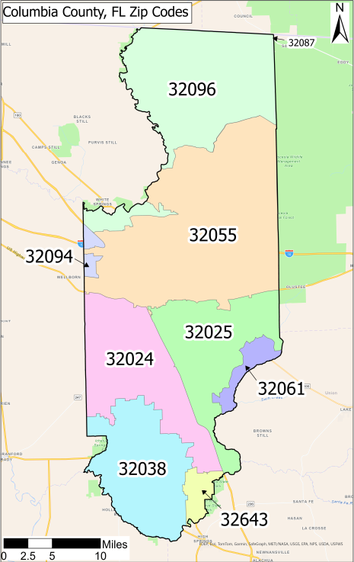
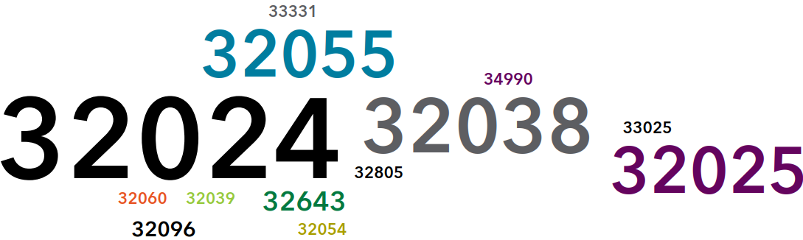
Which area code did we receive the most responses?
32024: Lake City
32038: Fort White
32055: Lake City
32025: Lake City

Slide 7
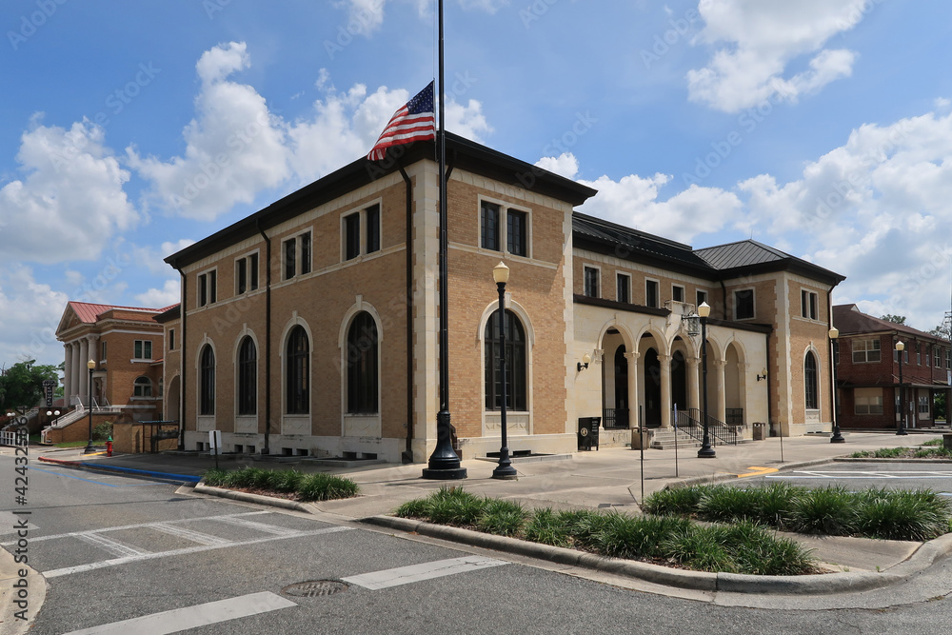
What excites you about the growth of the County?
“There is plenty of space within urban areas for us to build more homes.”
“More job opportunities, better shopping choices, more activities to do with a family.”
“More opportunities and jobs and affordable housing.”
“Nothing comes to mind. This is a great place to live.”
“The potential for culture and more things to do.”
“Economic stability.”
“Not excited by the growth.”
“The idea of doing well planned development in the right places with local input. The possibility of doing a “green community” that celebrates the value of natural resources.”
“Keeping the County rural and small town.”

Slide 8
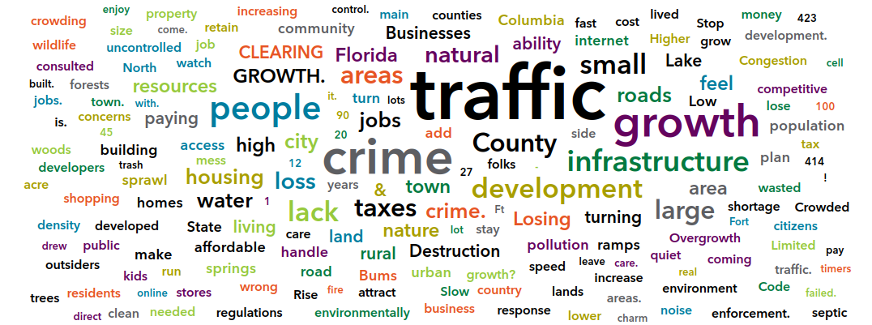
What concerns you about the growth of the County?

Slide 9
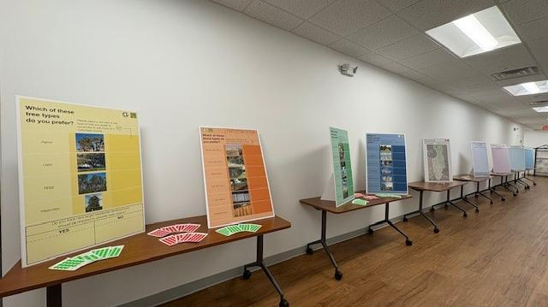
What concerns you about the growth of the County?
“Too much growth.”
“Traffic, housing, crime.”
“Destruction of nature and more parking lots.”
“Increased regulations that may come with growth.”
“Deforestation and water run off pollution into the springs.”
“Crime.”
“Crime, pressure on current service without expansions, and reengineering and rezoning without data for impacts.”
“Lack of activities and places for kids and teens.”
“Lack of public transportation and therefore traffic jambs. No way to widen US90 under I75.”

Slide 10
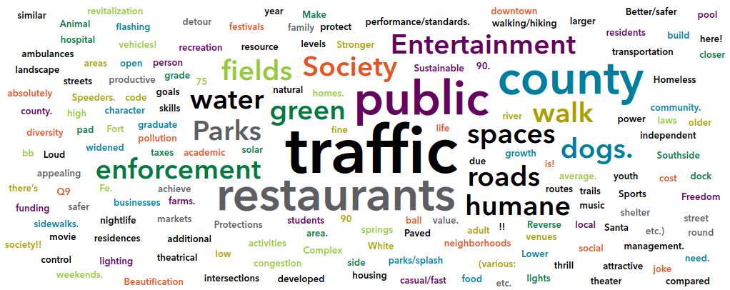
What community assets is missing from the County?

Slide 11
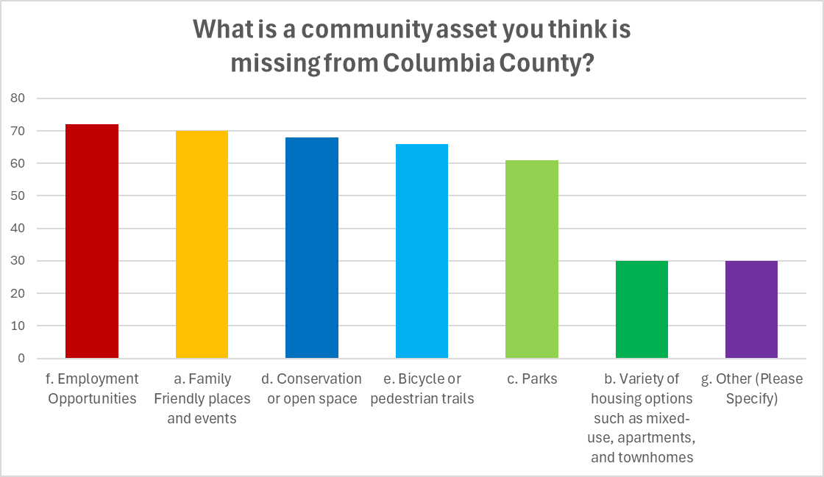

Slide 12
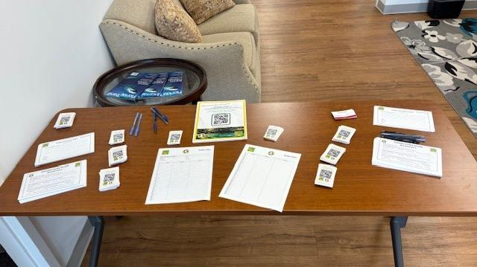
Tell us more about the housing options:
Many people chose not to answer this question
However, those who did… the results were all similar to the quotes below:
“Very little is affordable for young families and few rental spaces.”
“More affordable housing for our youth and first home owners.”
“Not everyone can afford to buy a home. Should have apartments that are pet friendly to rent.”
“More multifamily development projects need to be approved, encouraged, and recruited.”
“There is no places for our children to rent that is nice once they become adults. Nice townhomes or nice apartments that are well kept and have amenities that are kept up.”
“There are large tracts of vacant land in Lake city that are near or adjacent to mixed use and rental housing that could be utilized for affordable housing.”
“…we need to become a community that is accessible for developers looking to build multi-unit housing.”

Slide 13
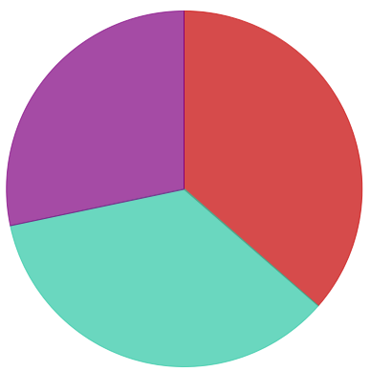
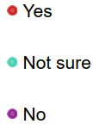
The County’s thoughts on signs:
Do you think the County should further regulate signs?
What type of sign do you prefer?
What type of sign do you dislike?
Wall Sign: 22.73%
Monument Sign: 21.02%
Digital Sign: 8.52%
Temporary Sign: 7.39%
Pole Sign: 5.68%
Billboard Sign: 5.11%
Billboard Sign: 27.27%
Pole Sign: 19.89%
Digital Sign: 15.91%
Temporary Sign: 14.77%
Wall Sign: 5.11%
Monument Sign: 3.41%
63
61
49

Slide 14
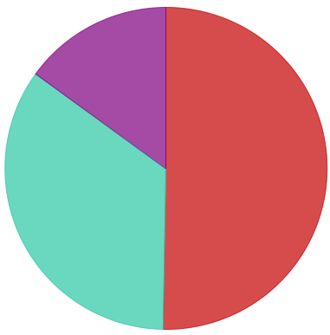
The County’s thoughts on fences:
Do you think the County should further regulate fencing?
What type of fence do you prefer?
What type of fence do you dislike?
Wooden Fence: 9.66%
Vinyl Fence: 8.52%
Split Rail Fence: 8.52%
Metal Fence: 7.39%
Chain Link Fence: 3.98%
Barbed Wire Fence: 0.57%
Barbed wire Fence: 13.07%
Chain Link Fence: 5.11%
Metal Fence: 2.84%
Vinyl Fence: 2.84%
Split Rail Fence: 1.14%
Wooden Fence: 1.14%
87
60
26
Notes:
Keep in mind not a ton of people wanted to regulate these.

Slide 15
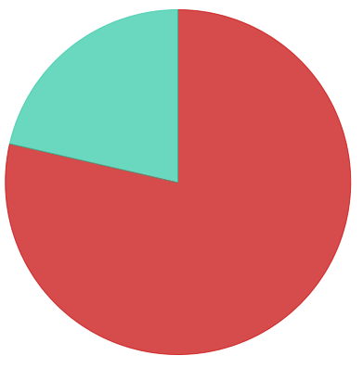

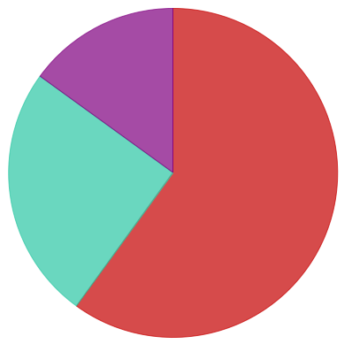

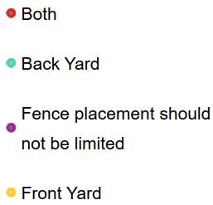

The County’s thoughts on fences:
How high should a front yard fence be?
Where should the fencing placement be limited to?
How high should a back yard fence be?
11
3
0
0
9
7
6
3
12
5
3
0

Slide 16
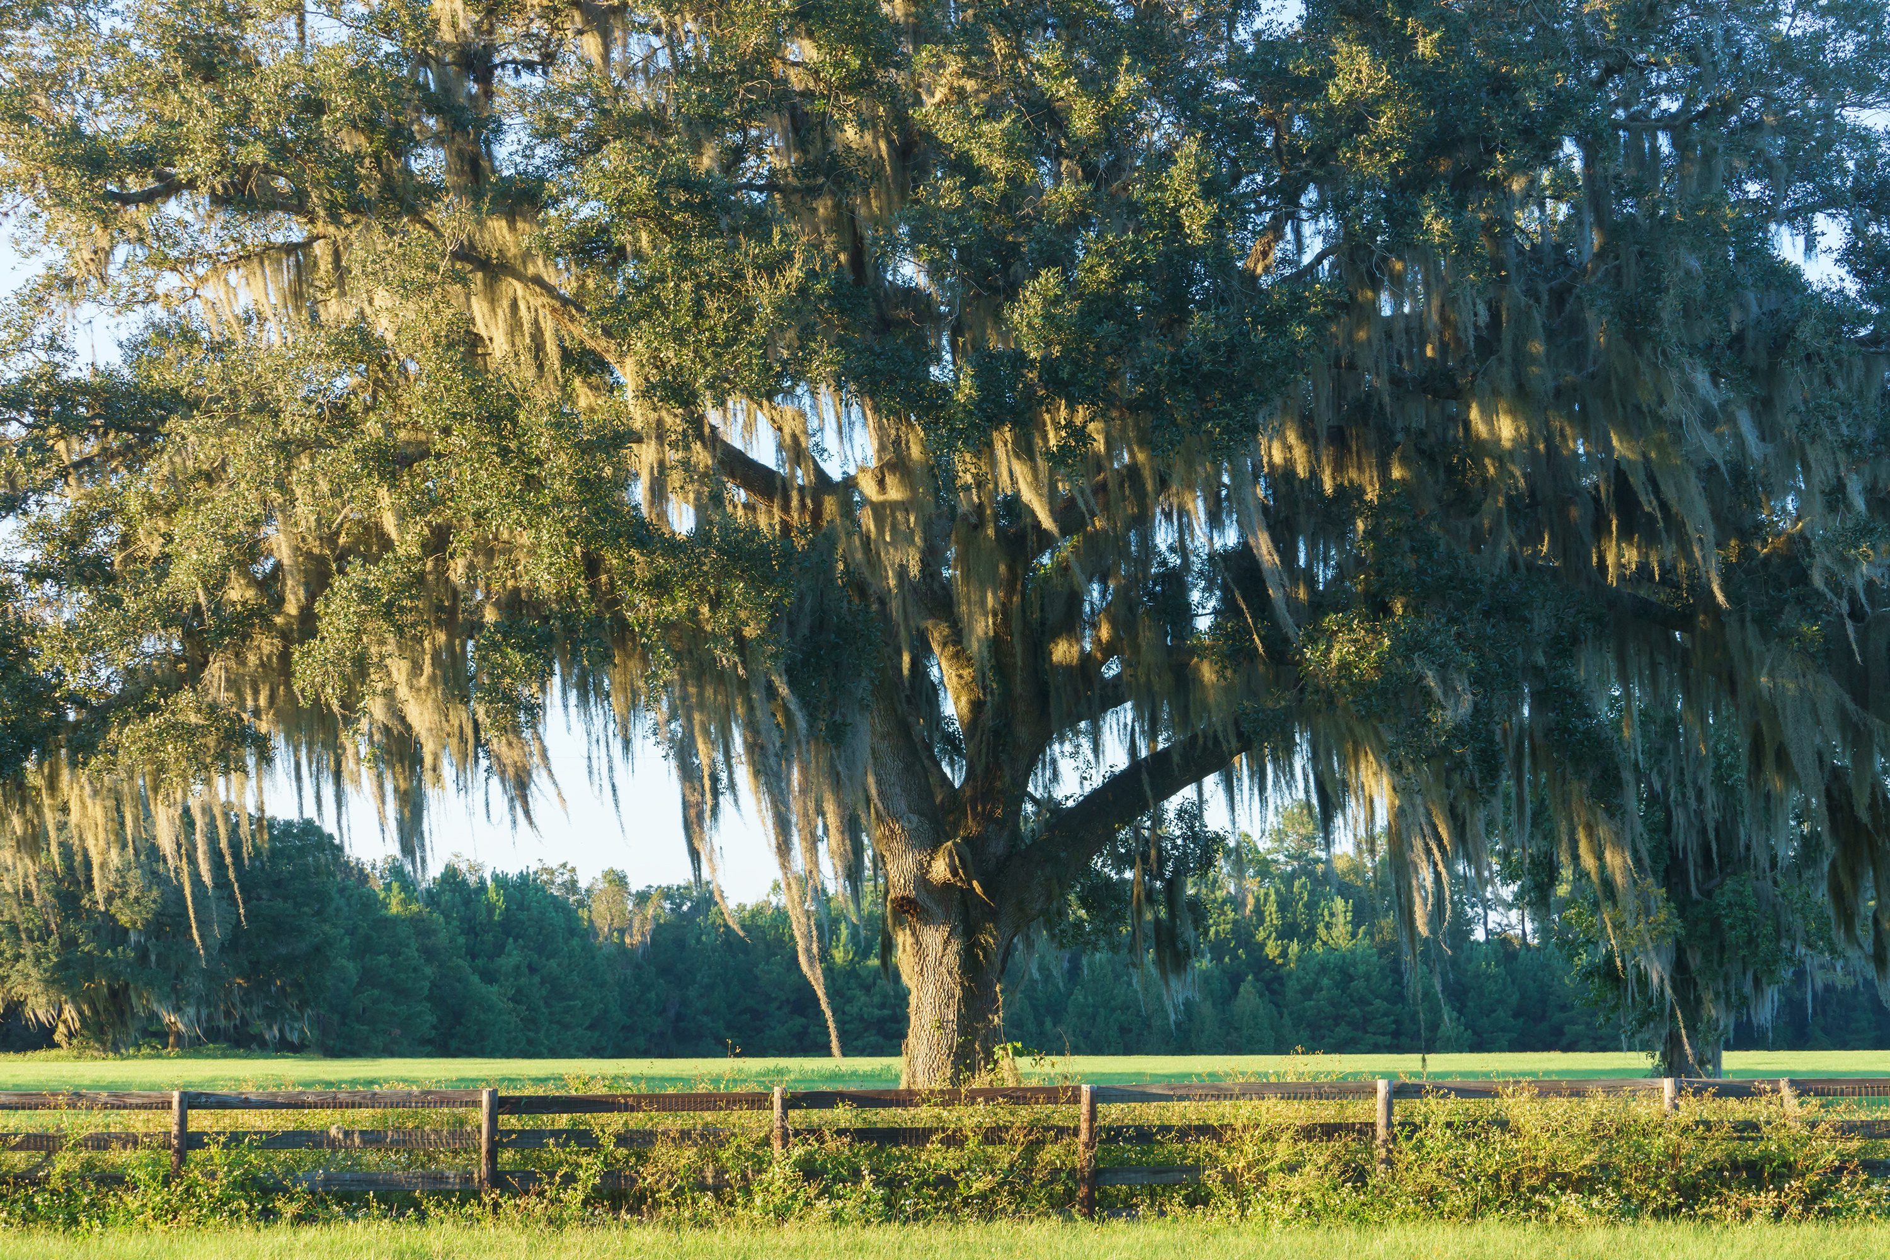
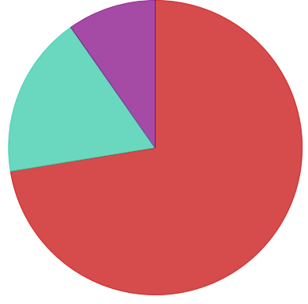
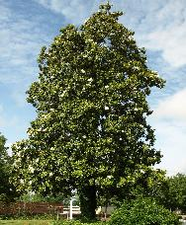
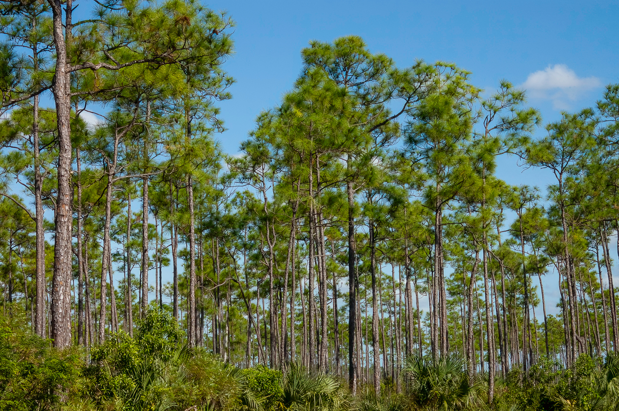
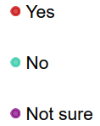
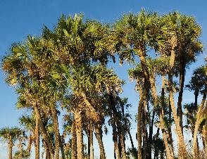
The County’s thoughts on trees:
Do you think new developments should be required to protect certain trees?
Which types of trees?
Oaks: 69.32%
Magnolias: 54.55%
Pines: 38.64%
126
31
17
Palms: 35.8%

Slide 17
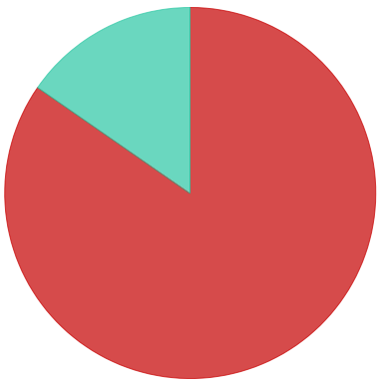
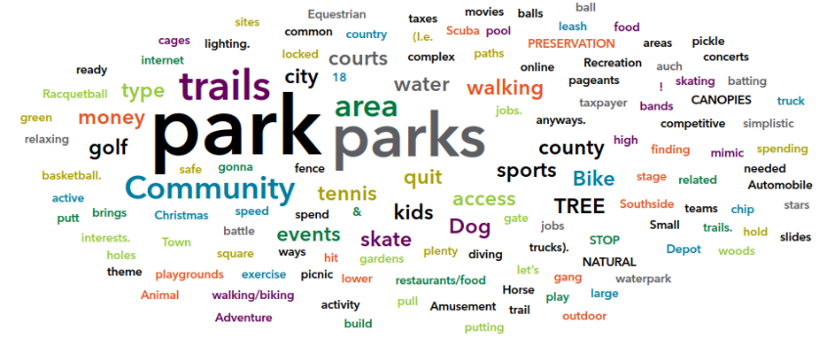

The County’s thoughts on parks and open space:
Do you think new larger residential developments should be required to provide open space?
What type of park do you prefer?
Nature Park: 76.14%
Community Park: 46.59%
Playground: 29.55%
Sport Complex: 20.45%
Other: 14.77%
143
26

Slide 18
Summary on Business and Development Meeting
Kimley-Horn and Columbia County staff met with Business Owners and Developers on July 25th, 2025. Below is a summary of the meeting:
Where should growth go?
Southern part of the County
5 Points area
Redevelopment of older areas
LDRs
Cluster development
Lot coverage – need logical setbacks
Smaller lot sizes and smaller lot widths
MSBU – review guidelines – ¼ area lot minimum
Missing MF product (especially market rate)
Fences
Fences okay for commercial, agricultural, and industrial.
Do not regulate materials and height
Trees
Do not regulate
Signs
Limit commercial signs in residential areas
Otherwise, no regulations
Housing
Proximity to amenities and jobs/transit
Encourage higher density areas
Non-residential demand
Asset
Park system
Ecotourism
Needs: rural commercial, monetized parks
No additional regulations
Ensure land uses are in the correct locations for job services

Slide 19
The County’s citizens overall comments:
LU not sufficient as established
Wanting to stay a small town
Retail. Revamp some of the abandoned buildings. Family friendly spaces.
Developers should pay their way. Impact fees should be realistic.
Plan for development areas
Plenty of land area (available land in DUDA limited)
Do not put new growth in our forests. If you’re out of space you’re out of space. Start reusing the property that already has old dilapidated buildings on it.
User friendly requirements - clear standards (limit need to call staff)
Growth should be located south of I-10, east of 75, north of 90 and west of 441.
We need no more growth. There aren't enough jobs for more people. It's mostly a low-wage, retail and restaurant desert, ideal for only retirees like me, who don't need a job.
No more RV parks.
I am concerned about the recent growth in the towns of Alachua and Newberry and do not want to see this type of issue impacting rural communities
I prefer NO MORE Growth!
No more hotels, dollar stores. You need another Publix on 47.

Slide 20
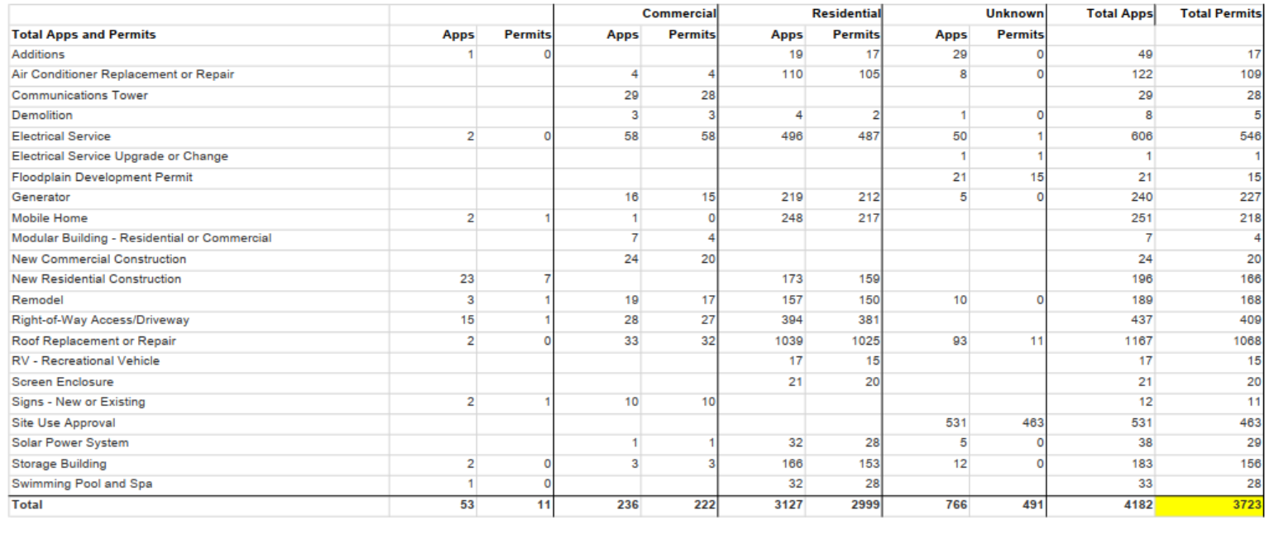
Building Permit Applications Oct 2025 - Sept 2025

Slide 21
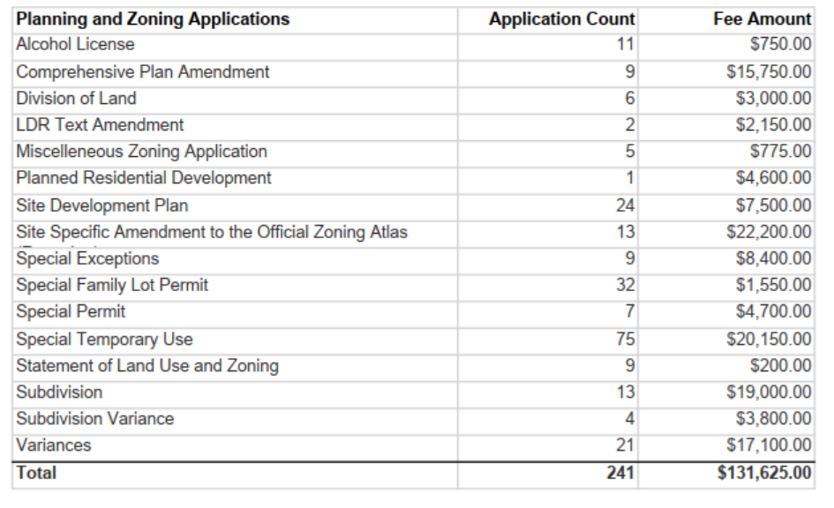
Zoning Applications Oct 2025 - Sept 2025

Slide 22
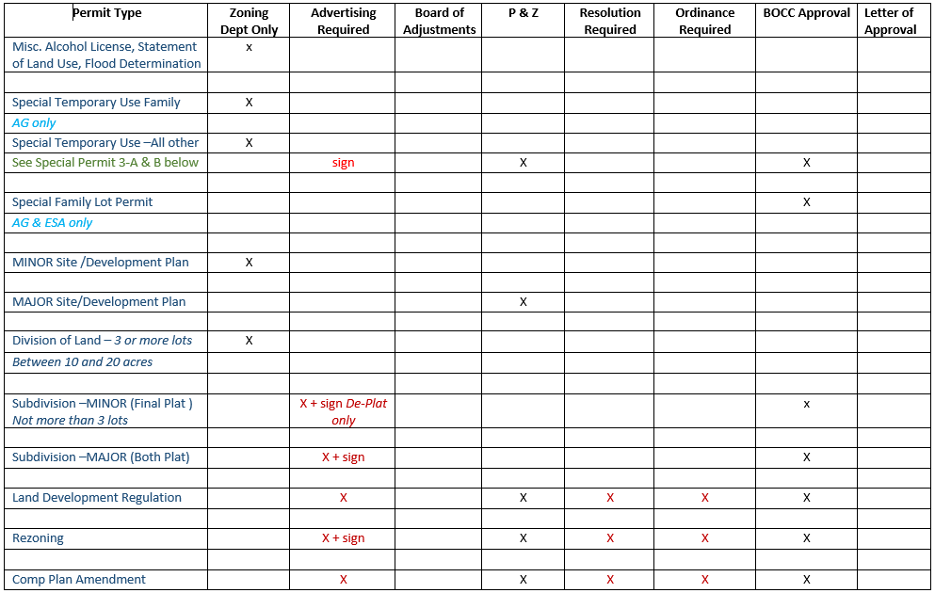
Permit Type Flow Chart
0
0
0
0
0
0

Slide 23
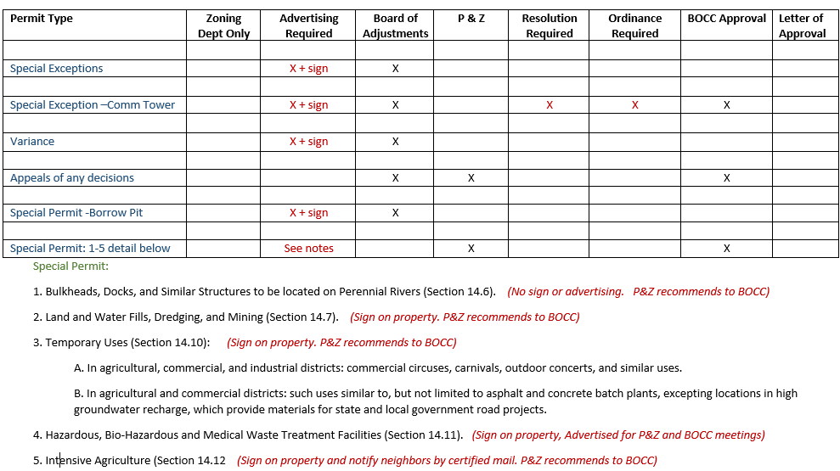
Permit Type Flow Chart
0

Slide 24
Preliminary Changes Proposed – Comp Plan
Review the elements for consistency with requirements in the Florida Statutes, primarily Chapter 163
Remove outdated language from all elements and consider opportunities to simplify and clarify
Add a definitions section
Incorporate recommendations of the Safety Action Plan into the Transportation Element
Reorganize the Future Land Use Categories to provide clarity in the list of permitted uses and clearly delineate between Urban and Rural
Create user-friendly tables for quick access
Emphasize development policies related to the DUDA and the Urban Area.
Review the Agriculture-2 on the Future Land Use Map for consistency with the existing development pattern
Evaluate the Future Land Use Map to determine if land use category distribution is reflective of good planning practices

Slide 25
Preliminary Changes Proposed – LDRs
Review format for clarify, simplify, and incorporate tables and figures to ease of reference
Remove outdated references, update formatting, modernize terminology, and incorporate requirement of Florida Statutes
Consolidate similar standards and requirements for ease of reference.
Update terminology for consistency throughout LDC
Create new sections that address all standards for landscaping/buffers and parking
Reorganize MUD, PRD and PRRD districts to simplify and clarify
Incorporate references to online permit submittal options
Consider options to organize and restructure Section 4.2 Supplementary District Regulations into topic areas for ease of navigation. (example parking, access management, specific use standards)
Evaluate eliminating Article 9 Minimum Housing Standards (Build Code is most appropriate)
Move Article 10 Hazardous Building Regulations to Code of Ordinances

Slide 26


Senate Bill 180 (SB 180) Summary
SB 180 prohibits jurisdictions within 100 miles of a hurricane’s path from imposing construction moratoria or adopting stricter land use amendments for one year after landfall. In regions affected by Hurricanes Debby, Helene, or Milton, (all FL Counties), more restrictive or burdensome regulations and moratoria are prohibited until October 1, 2027. Any measures in conflict are void retroactively from August 1, 2024.

Slide 27
OPEN DISCUSSION

Slide 28
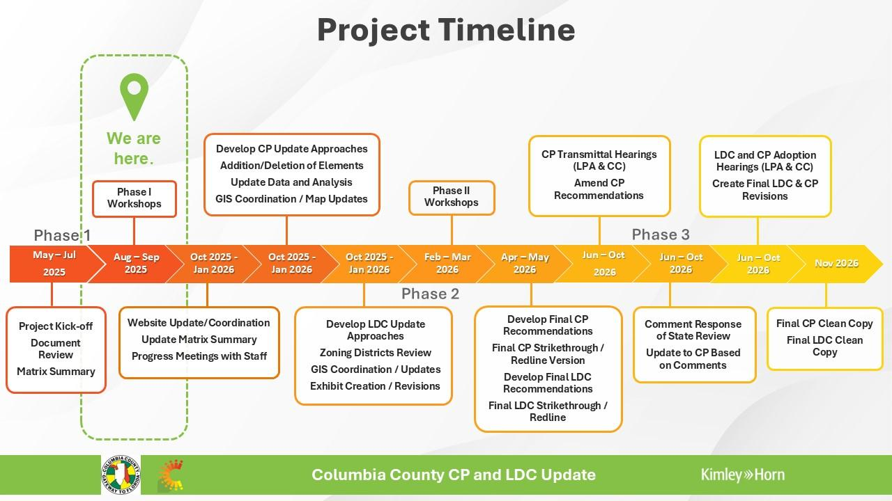

Slide 29

Thank you for your time!
Blair Knighting, AICP
blair.knighting@kimley-horn.com
904-828-3917

